Slide 1
SPACE SCIENCE AND EXPLORATION ISRO
SAGAR CHAND (25796) BSC(H) CS
GOVIND (25743) BSC(H) CS

Slide 2
What is ISRO?
ISRO (Indian Space Research Organisation) was formed on August 15, 1969 to apply space technology for national development and scientific discovery. Founded on Dr. Vikram Sarabhai’s vision, ISRO focuses on peaceful uses of space: communication, Earth observation, navigation, and science missions that benefit people across India.
Core Mission
Use space tech for societal development and scientific advancement.
Values
Affordability, reliability, and service to society.

Slide 3
EARLY DAYS
India’s space story began with INCOSPAR in 1962 and evolved into ISRO in 1969. Early achievements built technical foundations and confidence:
Aryabhata (1975):
L date: 19 April 1975
Launch site: Kapustin Yar, Russia (then Soviet Union)
Launch vehicle: Soviet Kosmos-3M rocket
Mass: 360 kg
Orbit: 563 × 619 km, inclination 50.7°
Mission type: Experimental (Astrophysics aunch & Aeronomy)
SLV-3 (1980)
Marked India’s entry into the league of spacefaring nations (1980).
Provided critical experience in solid propulsion, guidance, and control systems.
Served as the foundation for later vehicles like ASLV, PSLV, and GSLV.

Slide 4

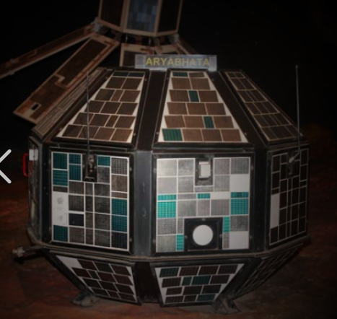
Major Milestones

Slide 5
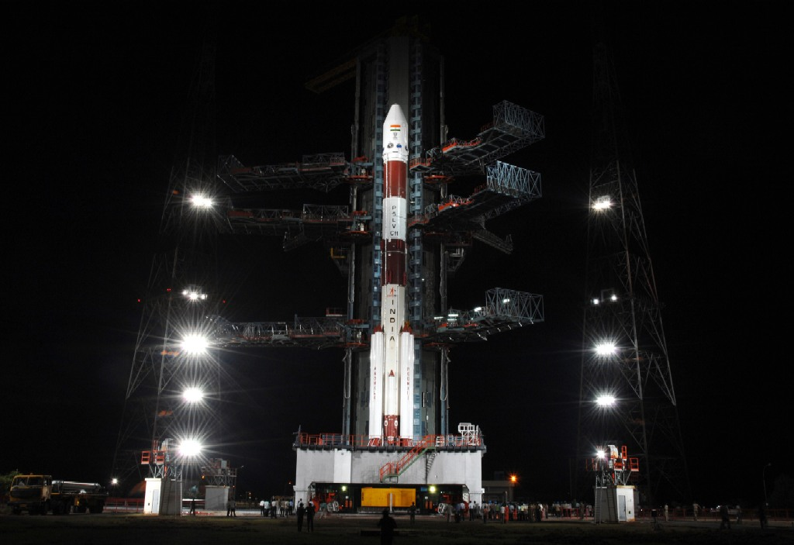
CHANDRAYAAN 1
INFO
Detected signatures of water on the Moon — a major scientific discovery.
Launch date: 22 October 2008
Launch site: Satish Dhawan Space Centre, Sriharikota
Orbit: Initially 100 km above lunar surface; later raised to 200 km in May 2009
Scientific Objectives
Chemical & mineralogical mapping of the Moon.
Photo-geologic mapping for surface features.
Detection of water molecules on the lunar surface (major discovery).
Study of lunar topography and exosphere.
Achievements
First Indian mission to the Moon.
Confirmed presence of water molecules on the lunar surface.
This Photo by Unknown Author is licensed under CC BY-SA-NC

Slide 6
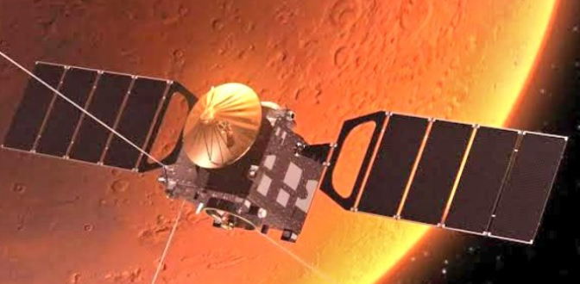
MANGALYAAN
First Asian mission to Mars; succeeded on first attempt at exceptionally low cost.
Launch date: 5 November 2013
Launch vehicle: PSLV-C25 (XL configuration)
Launch site: Satish Dhawan Space Centre, Sriharikota
Scientific Objectives
Demonstrate India’s capability to design, launch, and operate an interplanetary mission.
Study Martian surface features, morphology, mineralogy, and atmosphere.
Test autonomous spacecraft operations during deep-space travel.
Achievements
India became the first Asian nation to reach Mars orbit.

Slide 7
RECENT MISSIONS

Slide 8
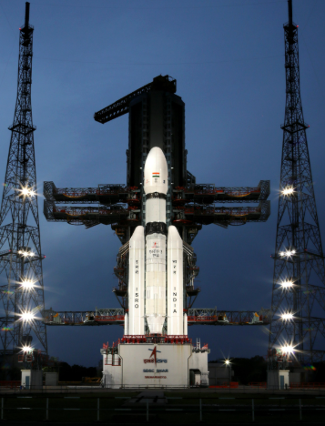
Chandrayaan 3
Successful soft landing near Moon’s south pole, rover conducting surface experiments and sending data.
Launch date: 14 July 2023
Launch vehicle: LVM3-M4 (GSLV Mk-III)
Achievements
Demonstrated autonomous landing technology with precision.
Rover confirmed presence of sulphur and other elements in lunar soil.
Impact
Boosted India’s global standing in planetary exploration.
Provided crucial data for future missions, including possible lunar resource utilization.

Slide 9
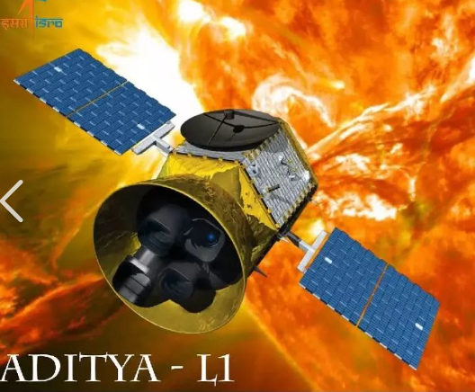
Aditya- L1 (2023)
Solar mission observing the Sun’s corona to improve understanding of space weather affecting Earth.
launch date: 2 September 2023
Launch vehicle: PSLV-C57 (XL configuration)
Mission duration: Planned 5+ years
Scientific Objectives
Continuous observation of the Sun without eclipses/occultations.
Study the photosphere, chromosphere, and corona.
Latest Updates (Feb 2026)
Successfully operating in halo orbit since January 2024.
Captured first high-energy X-ray glimpses of solar flares.
Significance
Strengthens India’s role in space weather forecasting.
Helps protect satellites, power grids, and communication systems from solar storm impacts.

Slide 10
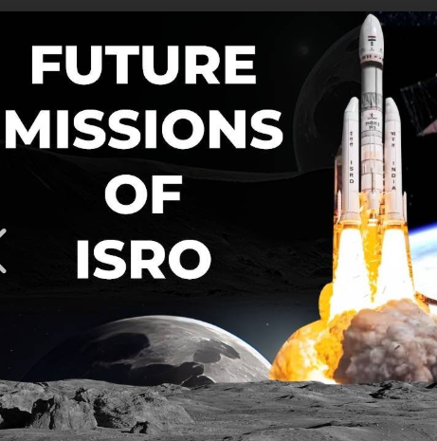
What’s Next for ISRO?
ISRO’s roadmap blends exploration, technology development, and service expansion:
Gaganyaan: Human spaceflight mission with crew training and life-support system validation.
Lunar follow-ups: Chandrayaan-4 and robotic missions to expand lunar science and resource mapping.
Interplanetary: Future missions to Mars and Venus are being studied to extend scientific reach.
Reusable Launch Vehicles: Developing reusability to lower costs and raise launch cadence.

Slide 11
How ISRO Helps Society and Earth

Slide 12
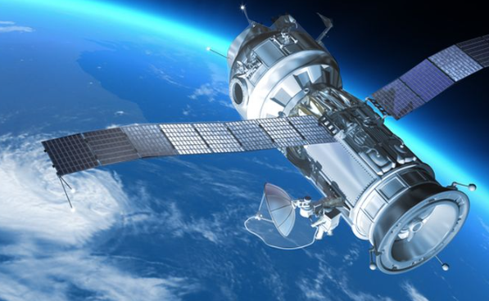
ISRO’s satellites and services deliver everyday benefits for millions:
Communication & Connectivity
INSAT/GSAT satellites revolutionized TV broadcasting, telecommunication, and internet services across India.
Enabled tele-education and telemedicine, connecting remote villages with schools and hospitals.
Weather & Disaster Management
INSAT and Meteorological satellites provide real-time weather forecasting, cyclone tracking, and monsoon monitoring.
Early warning systems for cyclones, floods, and droughts have saved countless lives

Slide 13
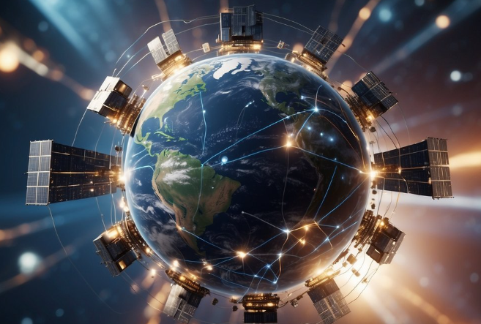
Agriculture & Resource Management
IRS and Resources at series help monitor crop health, estimate yields, and manage irrigation.
Bhuvan portal provides satellite-based maps for farmers, planners, and researchers.
Soil moisture and land-use mapping aid sustainable farming.
Security & Governance
RISAT series supports border surveillance and disaster response.
Satellite navigation systems (NavIC) provide precise positioning for transport, fisheries, and disaster relief.
Global Contributions
Affordable launch services via PSLV and GSLV have made India a trusted partner for other nations.
Strengthened India’s role in international disaster monitoring and space cooperation.

Slide 14
Why ISRO Matters
National Development:
Communication satellites (INSAT/GSAT) transformed TV, telecom, and internet access.
Remote sensing (IRS, Cartosat, Resourcesat) supports agriculture, water management, and urban planning.
Weather satellites provide cyclone warnings, saving thousands of lives.
Self-Reliance:
Indigenous launch vehicles (PSLV, GSLV, LVM3) reduced dependence on foreign launchers.
Affordable access to space strengthened India’s strategic autonomy.
Societal Impact:
Telemedicine and tele-education connected rural
communities.
Navigation system NavIC supports transport, fisheries, and disaster relief.

Slide 15
Write short notes on A landmark space mission by ISRO
Chandrayaan-3 was launched on 14 July 2023 by the LVM3 rocket and successfully landed on the Moon on 23 August 2023. The mission consisted of a Propulsion Module, the Vikram Lander, and the Pragyan Rover. With this achievement, India became the first country to land near the lunar south pole and the fourth nation overall to achieve a soft landing on the Moon. The lander carried instruments to study seismic activity, thermal properties, and plasma near the surface, while the rover analyzed lunar soil and confirmed the presence of sulphur and other elements. Chandrayaan-3 demonstrated India’s advanced space technology, strengthened its global standing in planetary exploration, and provided valuable data for future lunar resource utilization.

Slide 16
Global warming and climate change are two major concerns in modern times. Explain how science and technology are trying to address these two issues.
Satellites and sensors monitor greenhouse gases, deforestation, melting glaciers, and rising sea levels.
Supercomputers and climate models simulate future scenarios to guide policy.
AI and big data analyze weather patterns and predict extreme events.
Renewable energy technologies (solar, wind, bioenergy) reduce fossil fuel use.
Carbon capture and storage (CCS) traps harmful emissions.
Smart grids , energy efficient systems and electric vehicles cut carbon footprints.
Early warning systems powered by satellites and AI predict floods,cyclones and droughts.
Science provide knowledge to understand the crisis, while technology offers tools to mitigate and adapt

